Slide 1

CMR TECHNICAL CAMPUS Accredited by NBA, Approved by AICTE, affiliated to JNTUH Kandlakoya (V), Medchal Road, Hyderabad -501401
DEPARTMENT OF COMPUTER SCIENCE AND ENGINEERING
MAJOR PROJECT REVIEW ON
ADMISSION PREDICTION USING MULTIPLE LINEAR REGRESSION WITH PCA
Under the guidance
G. Vinesh Shankar GROUP NAMES
Dharani (187R1A05E7)
Neeshma (197R5A0513)
Dhruvaneshwar (187R1A05F0)
Shruthi (197R5A0510)

Slide 2
CONTENTS
Abstract
Existing System
Disadvantages
Proposed System
Advantages
Hardware Requirements
Software Requirements
Architecture
Modules
UML Diagrams
Sample Code
Results
Conclusion
Future Enhancement

Slide 3
ABSTRACt
In today's education world there are many numbers of students who want to pursue education or any graduate degree course . So our goal is to develop different models using machine learning which will tell the students their chance of admission into a respective university. These models should consider all the crucial factors which plays a vital role in student admission process and should have high accuracy. The predicted output gives them a fair idea about their admission chances in a particular university.

Slide 4
EXISTING SYSTEM
The existing system is that it causes issue, Students admission is one of the most important activities in education industry. In existing system it contains algorithms like random forest regression , K-Nearest Neighbours etc , which contains of high errors , and less accuracy.

Slide 5
DISADVANTAGES
Less efficient.
The currently available resources is that they are very limited.
They are not truly dependable taking into consideration of their accuracy and reliability.

Slide 6
PROPOSED SYSTEM
The main goal of the system is to automate the process carried out in the organization with improved performance and realize the vision of admission. The predicted output gives them a fair idea about their admission chances in a particular university.
The Admission Prediction system predicts the probability of students getting admitted in a university by applying regression algorithms such as: Multiple linear regression with pca. The main objective of this model is to predict whether the student he/she gets admission or not in the universities.

Slide 7
ADVANTAGES
Higher efficiency for prediction.
That have high accuracy
Improves the quality of the process

Slide 8
REQUIREMENTS
HARDWARE REQUIREMENTS:
The basic requirements for Admission prediction are:
Input Devices : Keyboard , Mouse.
Hard Disk : 10GB
Ram : 1GB
SOFTWARE REQUIREMENTS:
Operating system : Windows 7,8,10
Coding Language : Python
Tool : PyCharm

Slide 9
ARCHITECTURE

Slide 10
Start
Dataset
Preprocessing
Training
Testing
Multiple Linear
Regression using PCA
Decision
User Data
Algorithm
Result
Stop

Slide 11
MODULES
DATA GATHERING:
Data gathering is the process of collecting and measuring information from countless different sources.
In order to use the data we collect to develop practical machine learning solutions, it must be collected.
The dataset has been collected from students of different colleges. The dataset collected consist of instances of students.
To use the dataset in our code, we usually put it into a CSV file.

Slide 12
DATA-PREPROCESSING:
Data preprocessing is a technique that is used to convert raw data into a clean dataset.
The data is gathered from different sources is in raw format which is not feasible for the analysis.
In order to perform data preprocessing using Python, we need to import some predefined Python libraries they are :
Numpy: Numpy Python library is used for including any type of mathematical operation in the code.
Pandas: The last library is the Pandas library, which is one of the most famous Python libraries and used for importing and managing the datasets.
Matplotlib – Matplotlib is a Python 2D plotting library that is used to plot any type of charts in Python.
Pre-processing for this approach takes 3 simple yet effective steps:

Slide 13
Attribute Selection: The attribute like serial no. is not required. The main attributes used for this study are GRE Scores, TOEFL Scores, CGPA, and University Ranking.
Cleaning missing values: The library used for the task is called Scikit Learn preprocessing. It contains a class called Imputer which will help us take care of the missing data.
Feature Scaling : It is performed during the data pre-processing to handle highly varying magnitudes or values or units.
If feature scaling is not done, then a machine learning algorithm tends to weight greater values, higher and consider smaller values as the lower values, regardless of the unit of the values.
A feature scaling in machine learning model is based on Euclidean distance.
Training and Test data Splitting the Dataset into Training set and Test Set: The next step is to split our dataset into two. Training set and a Test set.
We will train our machine learning models on our training set and then we will test the models on our test set to examine how accurately it will predict.
A general rule of the thumb is to assign 75% of the dataset to training set and therefore the remaining 25% to test set.

Slide 14
Machine learning models
They are several ML models have to be developed using various machine learning algorithms for admission prediction to a particular university. Algorithms are :
MULTIPLE LINEAR REGRESSION WITH PCA:
Multiple regression analysis is one of the most widely used methodologies for expressing the dependence of a response variable on several predictor variables.
Due to the presence of multicollinearity, the standard errors of the parameter estimates could be quite high.
The specific goals of principal component analysis are to reduce a large number of predictor variables to smaller no. of principal components and to provide a regression equation for an underlying process by using predictor variables.
Principal components can be derived such that they are nearly uncorrelated or orthogonal. Thus the problem of multicollinearity among the variables can be solved by using PCA.

Slide 15
PRINCIPAL COMPONENT ANALYSIS PCA
It is considered to be one of the most used unsupervised algorithms and can be seen as the most popular dimensionality reduction algorithm.
It is a linear dimensionality reduction technique that can be utilized for extracting information from a high-dimensional space by projecting it into a lower-dimensional sub-space.
It tries to preserve the essential parts that have more variation of the data and remove the non-essential parts with fewer variation. Dimensions are nothing but features that represent the data.
ADVANTAGES OF PCA
It reduces computation time.
It also helps remove redundant features, if any
APPLICATIONS OF PCA
PCA is used as a dimensionality reduction technique in domains like facial recognition, computer vision and image compression.
It is also used for finding patterns in data of high dimension in the field of finance, data mining, bioinformatics, psychology, et

Slide 16
PREDICTION:
Multiple Linear Regression model with PCA compared to other ones was the best suited model because it had the highest accuracy and the least error . Students can use the model to assess their chances of getting admission into a particular university with an average accuracy of 83 percent. The predicted output gives them a fair idea about their admission chances in a particular university.
ERROR AND ACCURACY :
MSE : MLR (PCA) < RFR (PCA) < RFR < MLR
RMSE : MLR (PCA) < RFR (PCA) < RFR < MLR
ACCURACY : MLR < RFR < RFR (PCA) < MLR (PCA)

Slide 17
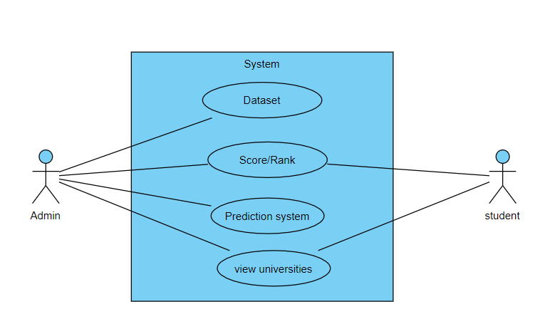
USECASE DIAGRAM

Slide 18
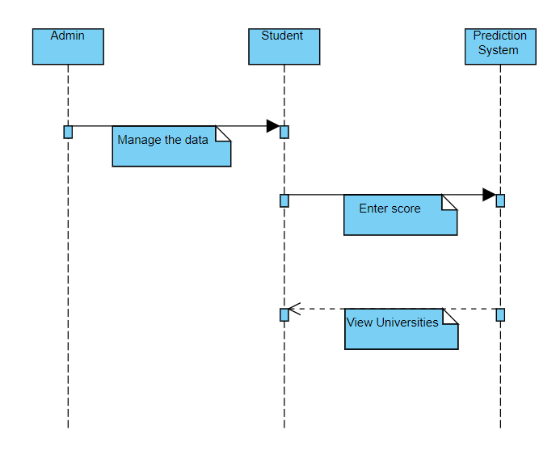
SEQUENCE DIAGRAM:

Slide 19
CLASS DIAGRAM
Student
Admin
Name
Gre Score
Tofel score
Rating
University Name
Rating
Chance of admission
View the University
Manage dataset

Slide 20
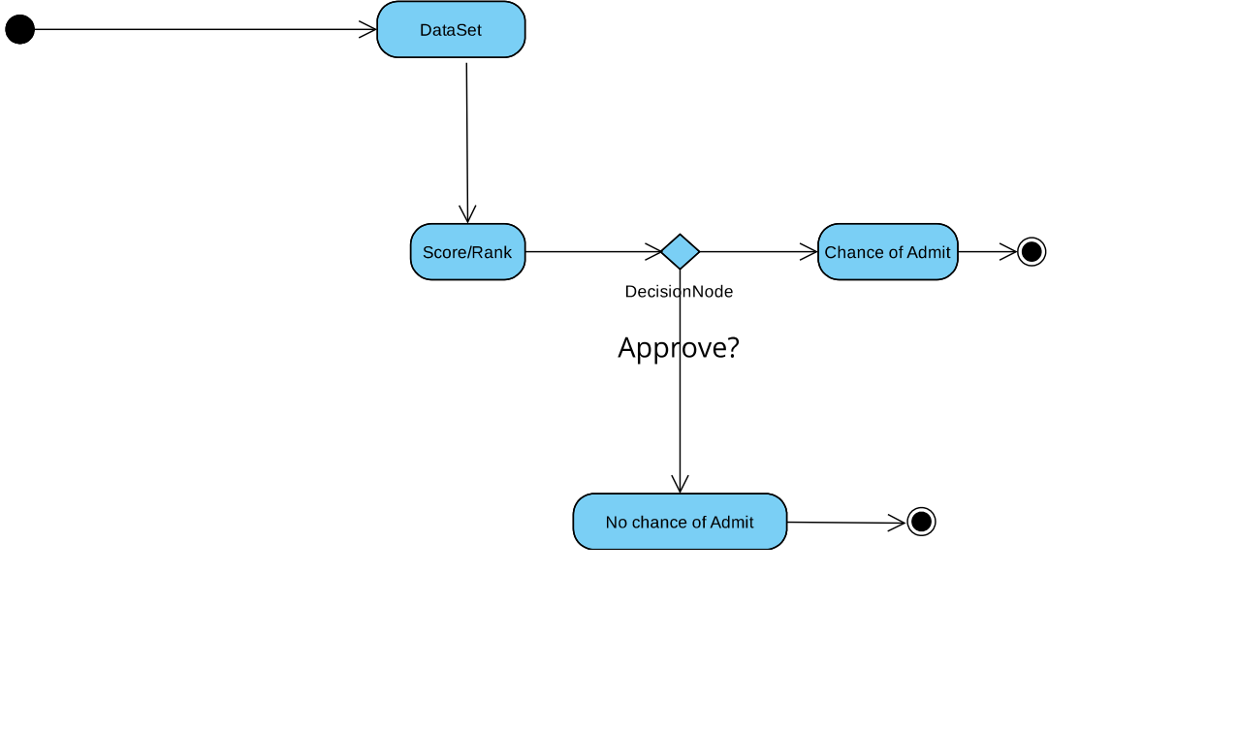
ACTIVITY DIAGRAM:

Slide 21
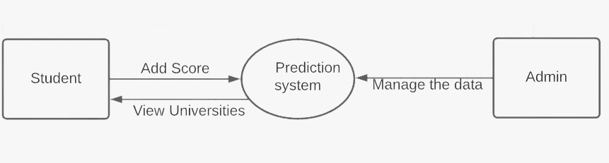
DATA FLOW DIAGRAM

Slide 22
Sample code

Slide 23
import numpy as np
import pandas as pd
import matplotlib.pyplot as plt
df = pd.read_csv("/content/drive/MyDrive/Colab Notebooks/Admission_Predict.csv")
print(df)
from sklearn.preprocessing import StandardScaler
sc= StandardScaler()
x = sc.fit_transform(x)
print(x)

Slide 24
from sklearn.decomposition import PCA
pca = PCA(n_components=None)
x = pca.fit_transform(x)
print(pca.explained_variance_ratio_)
plt.plot(np.cumsum(pca.explained_variance_ratio_))
//train and test the data //
from sklearn.model_selection import train_test_split
x_train,x_test, y_train,y_test = train_test_split(x,y,test_size=0.25,random_state=50)

Slide 25
from sklearn.linear_model import LinearRegression
lr = LinearRegression()
lr.fit(x_train,y_train)
from sklearn.metrics import r2_score,mean_absolute_error,mean_squared_error
r2 = r2_score(y_test,y_pred)
mae=mean_absolute_error(y_test,y_pred)
mse=mean_squared_error(y_test,y_pred)
rmse=np.sqrt(mse)
print('r2_score=',r2)
print('mae=',mae)
print('mse=',mse)
print('rmse=',rmse)
plt.scatter(y_test, y_pred, color = 'red')
plt.scatter(y_test, y_test, color = 'blue')
plt.xlabel('Actual vales')
plt.ylabel('Predicted values')
plt.title('Actual vs Prediceted values')
plt.show()

Slide 26
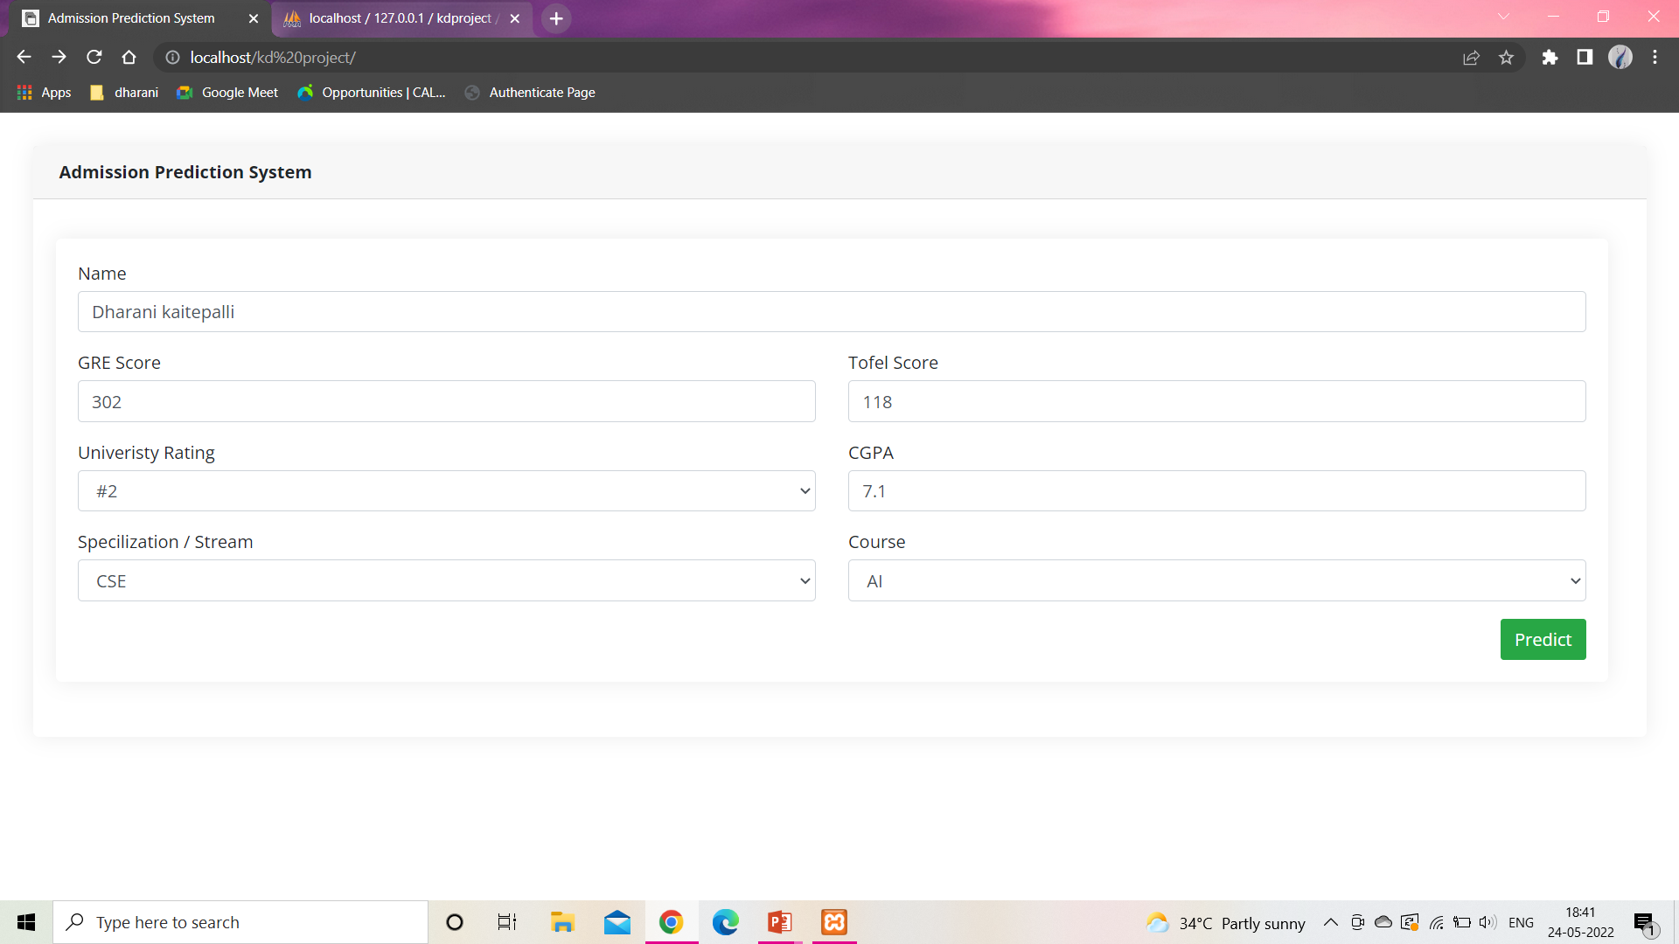
RESULTS

Slide 27
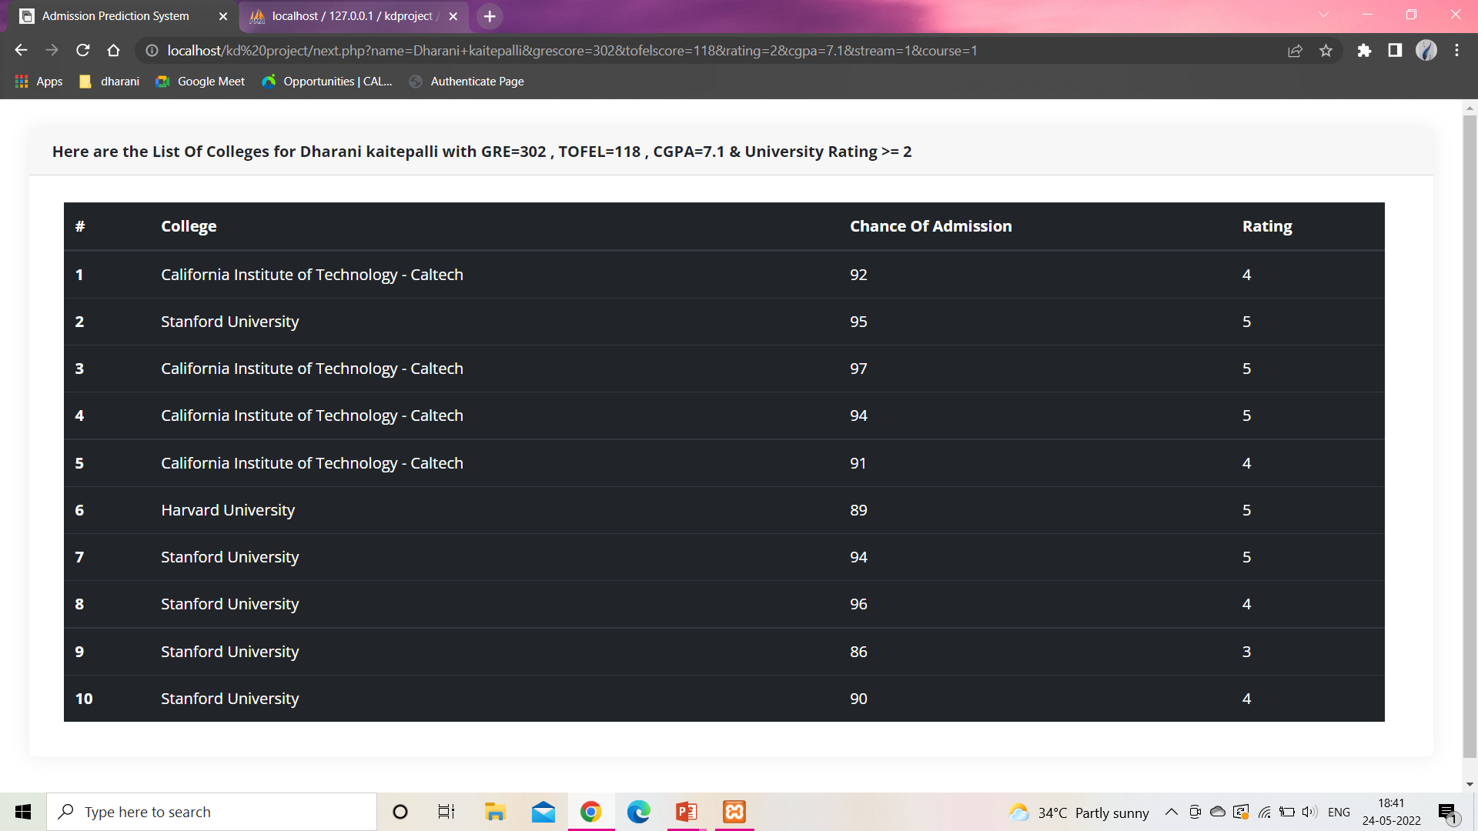

Slide 28
CONCLUSION
The main goal of this project is to create a Machine Learning model which could be used by students who want to pursue their education in the US. Students can use the model to assess their chances of getting admission into a particular university. Multiple linear regression with pca proved to best-fit for development of the system when compared with the Linear regression model. The model can be used by the students for evaluating their chances of getting shortlisted in a particular university with an average accuracy of 85%.

Slide 29
FUTURE ENHANCEMENT
In future, more data related to additional universities and courses can be added to the system. Also, the system can be enhanced to a application by making changes to the code. Other classification algorithms can be evaluated to resolve the problem if they perform better than the current algorithm the system can be easily updated to support the new algorithm by changing the server code.

Slide 30
THANK YOU

